Slide 1
PreACT
Understanding your PreACT score report

Slide 2
The PreACT Breakdown
What is the PreACT?
What should I do next?
How can I improve my score?
PreACT and the ACT® tests cover the same subject areas: Math, Science, English, Reading.
The PreACT and the ACT measure your college readiness skills as you progress through high school.
PreACT scores can be used to predict how you’ll score when you take the ACT as an 11th grader.
Meet with Mrs. Lackey for an in depth look at your scores and to develop a personalized plan.
Work with your teachers in subject areas you wish to improve (look at detailed results on your score report).
Keep in mind that the score range for ACT is only an estimate. You need to keep working at learning to ensure the highest score possible.
Review your score report for areas where you scored below the Readiness Benchmark.
Utilize free resources from www.act.org
Additional free ACT resources can be found here

Slide 3
PreACT Score Reports
Test Scores
Composite Score
Detailed Scores
Pre ACT 8/9 scores are between 1 and 30.
Pre ACT scores are between 1 and 35.
Each test area provides a score range. On your report these are in colored boxes.
The light gray lines with the numbers next to it are the ACT Readiness Benchmarks.
Compare your scores to the Benchmarks to see if you are prepared for 1st year college courses.
You will find a list of topics covered by questions in each of the four subject tests.
Next to each topic is the number you got correct out of the total number of questions. The percent of questions answered correctly is also shown.
The bar graph illustrates your strongest and weakest areas.
Your composite score is the average of the English, math, reading, and science test scores.
Your STEM score is the average of the math and science test scores. This shows how well you did with questions in science, technology, engineering, and math.

Slide 4
Score Report Analysis
Understanding your ACT score report

Slide 5
Pre ACT 8/9, Pre ACT, and ACT Benchmarks
You are on track to be college ready if you scored at least the following in each tested area.
 | Math | Science | STEM | English | Reading
Pre ACT 8/9 | 17 | 18 | 21 | 12 | 17
Pre ACT 10 | 19 | 20 | 23 | 14 | 19
ACT 11 | 22 | 23 | 26 | 18 | 22

Slide 6
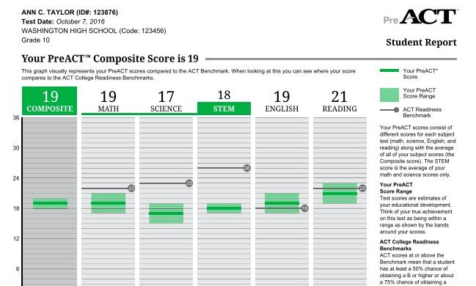

Slide 7
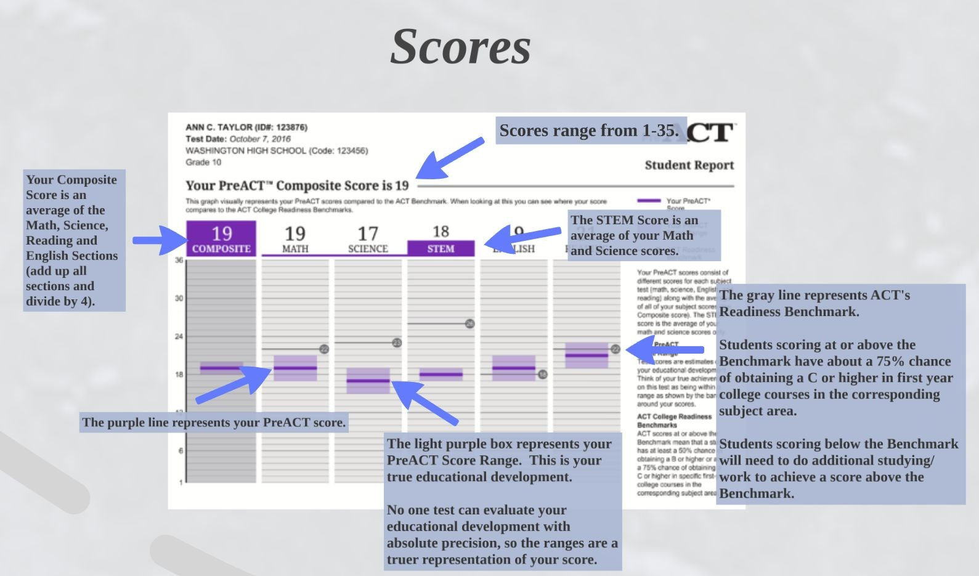

Slide 8
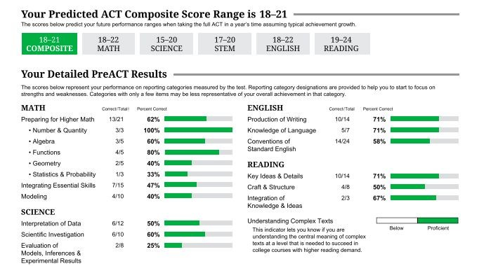

Slide 9
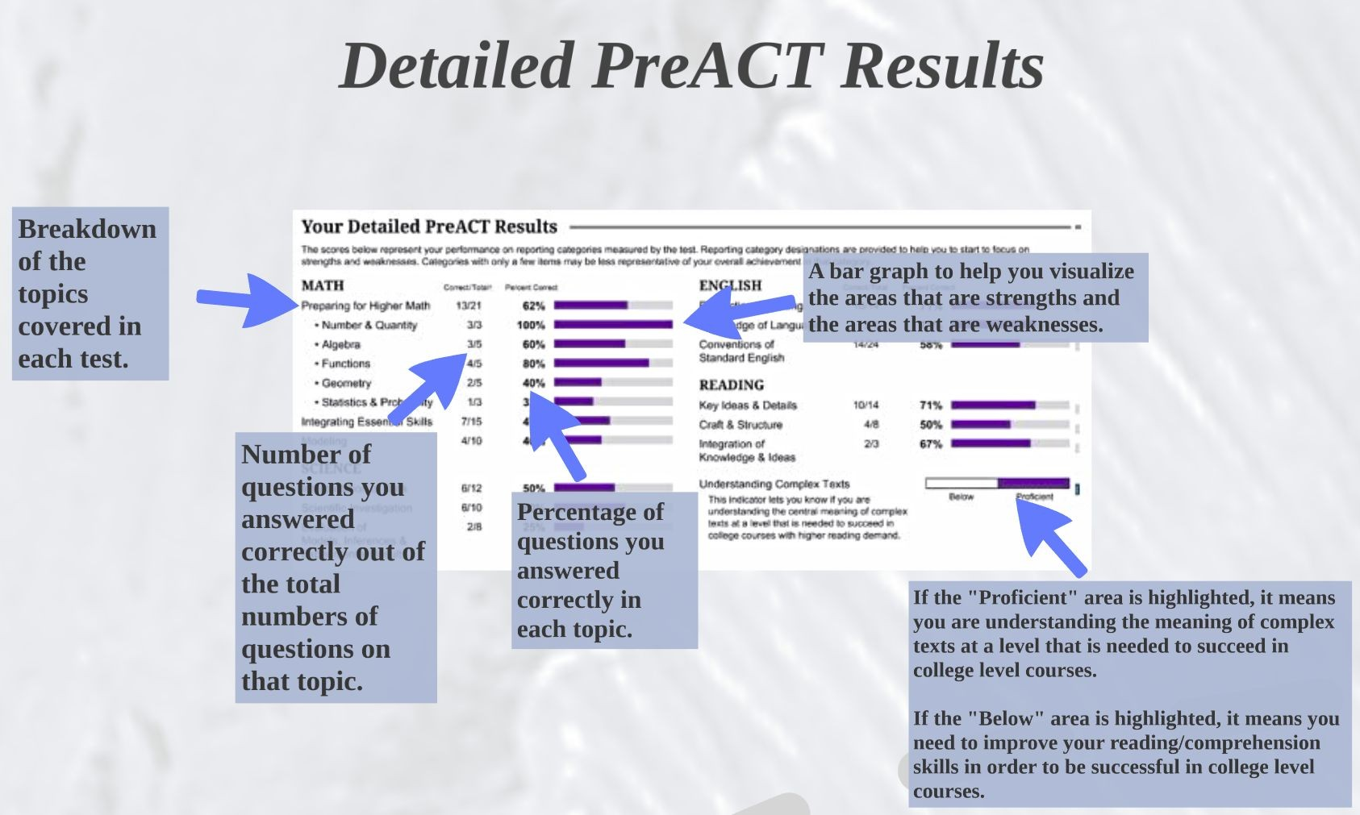

Slide 10
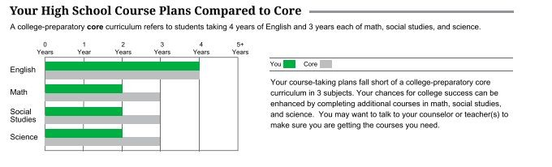
Your High School Course Plans

Slide 11
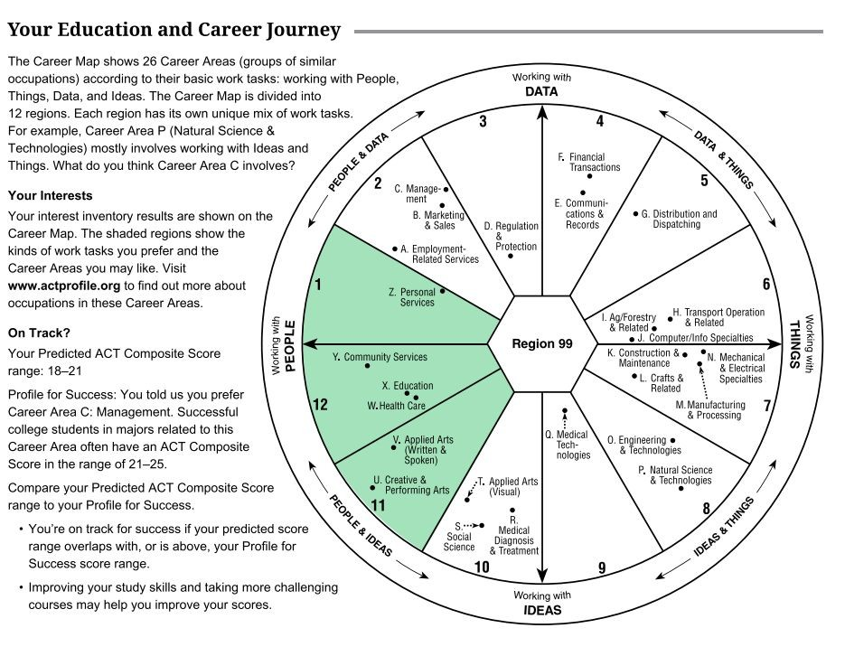
Career Interests

Slide 12
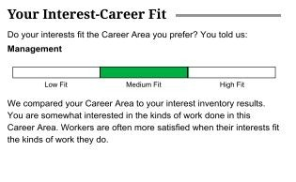
Interests and Career Fit

Slide 13
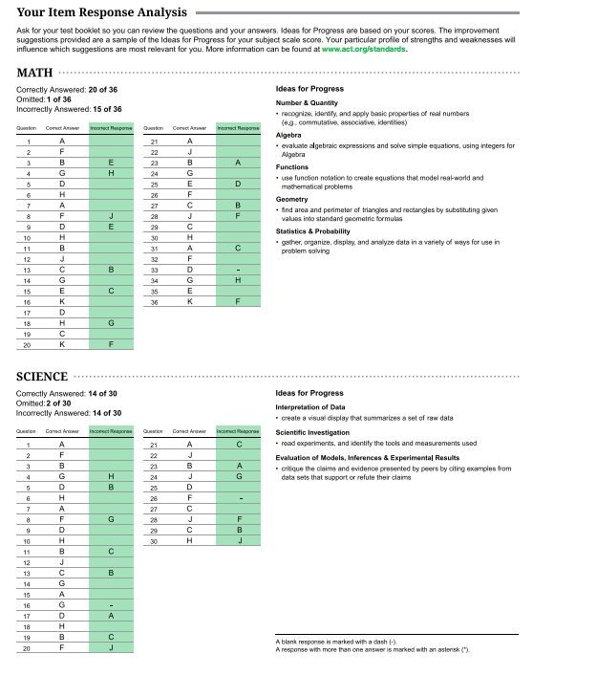
Your Item Responses

Slide 14
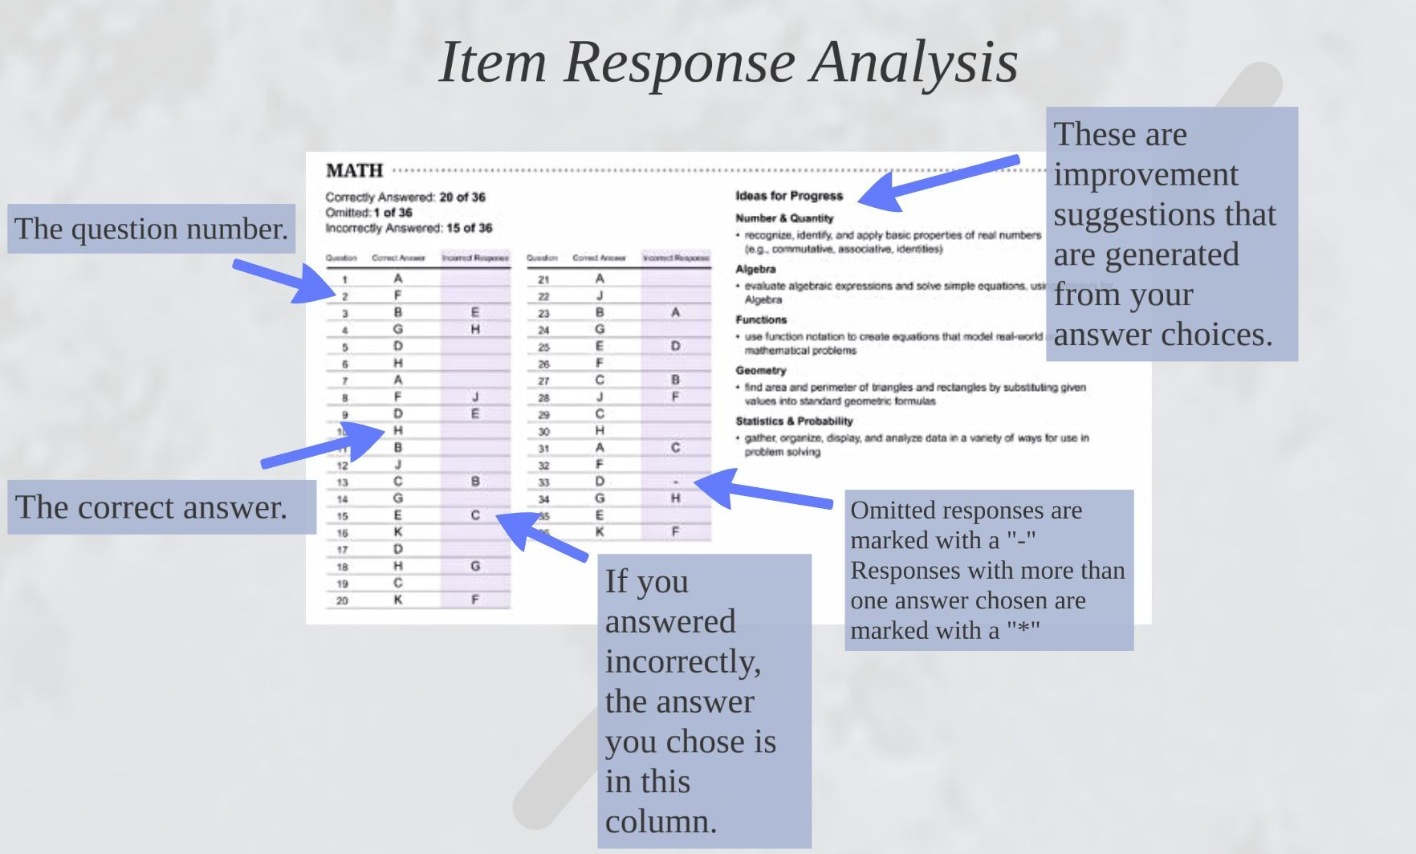

Slide 15
How can I prepare for the ACT?
ACT Test Prep & Free Resources
Free Study Guide
Question of the day
Free Practice for each test section
General Test Tips
Test Descriptions
  www.act.org
ACT Kaplan Online Resources
  All ACT Kaplan resources are free to any student registering for the ACT with a fee waiver.
  Free recorded videos for all students for each content area.
    https://kaplan.com/

Slide 16




All 10th graders take the PreACT
Prepare for ACT. Utilize all free resources. Take courses to strengthen
Review ACT score reports. Determine if you need to test again.
skills.
Fall of 10th Grade
Winter of 10th grade
Spring of 10th Grade - Spring of 11th Grade
Feb. of 11th Grade
April of 11th Grade
All 10th graders receive PreACT scores
Final preparations for school administered ACT. All 11th graders take the ACT.

Slide 17
What score do I need on the ACT?
Average SAT and SAT score ranges for NC public colleges
All juniors take the ACT for free in February each year.
Recommended to take SAT and ACT junior year, then take whichever exam you liked best a second time.
The higher your test score, the more likely you are to be admitted to competitive college majors, earn scholarships, and be considered for college honors programs.
 | SAT range | ACT range | GPA range
Appalachian State | 1100-1270 | 22-28 | 3.82-4.34 (weighted)
East Carolina | 1070-1190 | 19-24 | 3.10-3.41 (unweighted)
Elizabeth City St. | 890 | 18 | 3.19
Fayetteville State | 942 | 18 | 3.27
NC A&T State | 1080 | 21 | 3.7 (weighted)
North Carolina Central | 929 | 18 | 3.27
NC State University | 1310 | 29 | 4.17-4.48 (weighted)
UNC Asheville | 1176 | 25 | 3.5
UNC Chapel Hill | 1350-1500 | 29-34 | 4.39+ (weighted)
UNC Charlotte | 1130-1280 | 22-27 | 3.8-4.5 (weighted)
UNC Greensboro | 1110-1200 | 23 | 3.74 (weighted)
UNC Pembroke | 1023 | 19 | 3.44
UNC Wilmington | 1277 | 24-28 | 4.06 (weighted)
Western Carolina | 1150 | 23 | 3.78 (weighted)
Winston-Salem State | 963 | 18 | 3.31 (weighted)

Slide 18
PSAT information
PSAT in depth information
Understanding your PSAT scores
SAT vs. ACT how scores compare
Khan Academy Official SAT practice

Slide 19
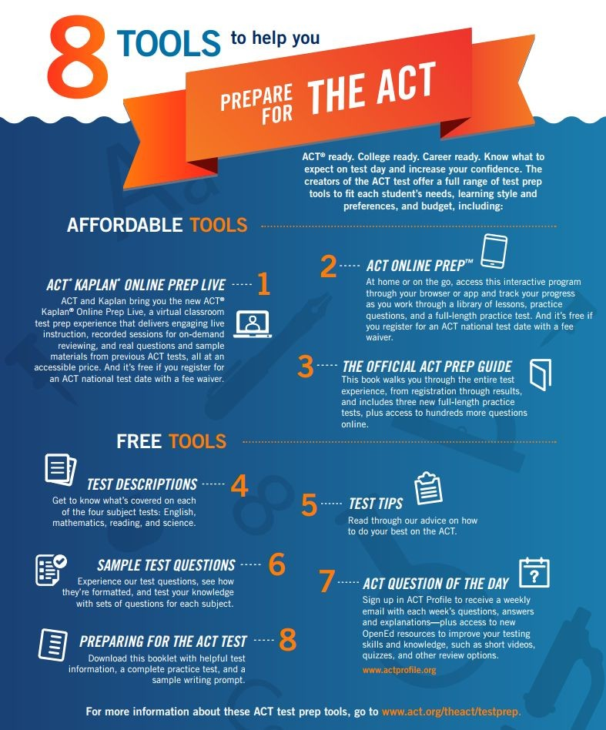
Questions?
Please see your teacher or school counselor if you have additional questions.

